Slide 1
Aprimo Collections Lightning Component

Slide 2
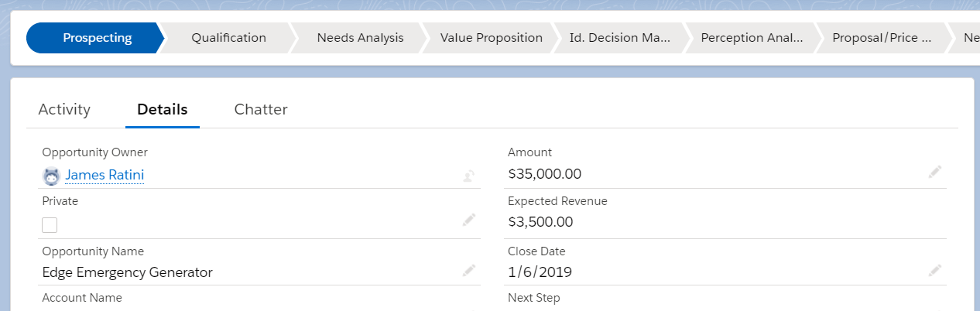
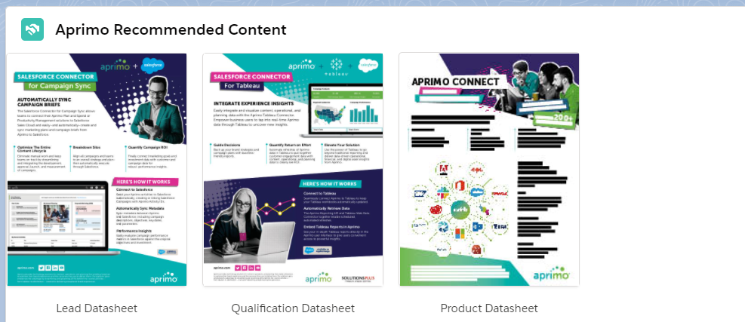
Aprimo DAM Collections Lightning Component
With Aprimo Collections Salesforce Lightning Component automatically surface content in Salesforce relevant to the context of Opportunities, Leads, Accounts, Campaigns, or other Salesforce objects.

Slide 3


Features
The Aprimo Collections Salesforce Lightning Components allows customers to surface content relevant to the current context of Opportunities, Leads, Account, or other Salesforce objects
Configurable Collection Mapping allows for different Aprimo collections to be surfaced based off different Salesforce data
Deep Link allows users to click through from Salesforce right into Aprimo
Download Aprimo assets as attachments on the Salesforce object
Open Source allows for customers to customize the connector to fit their use case

Slide 4
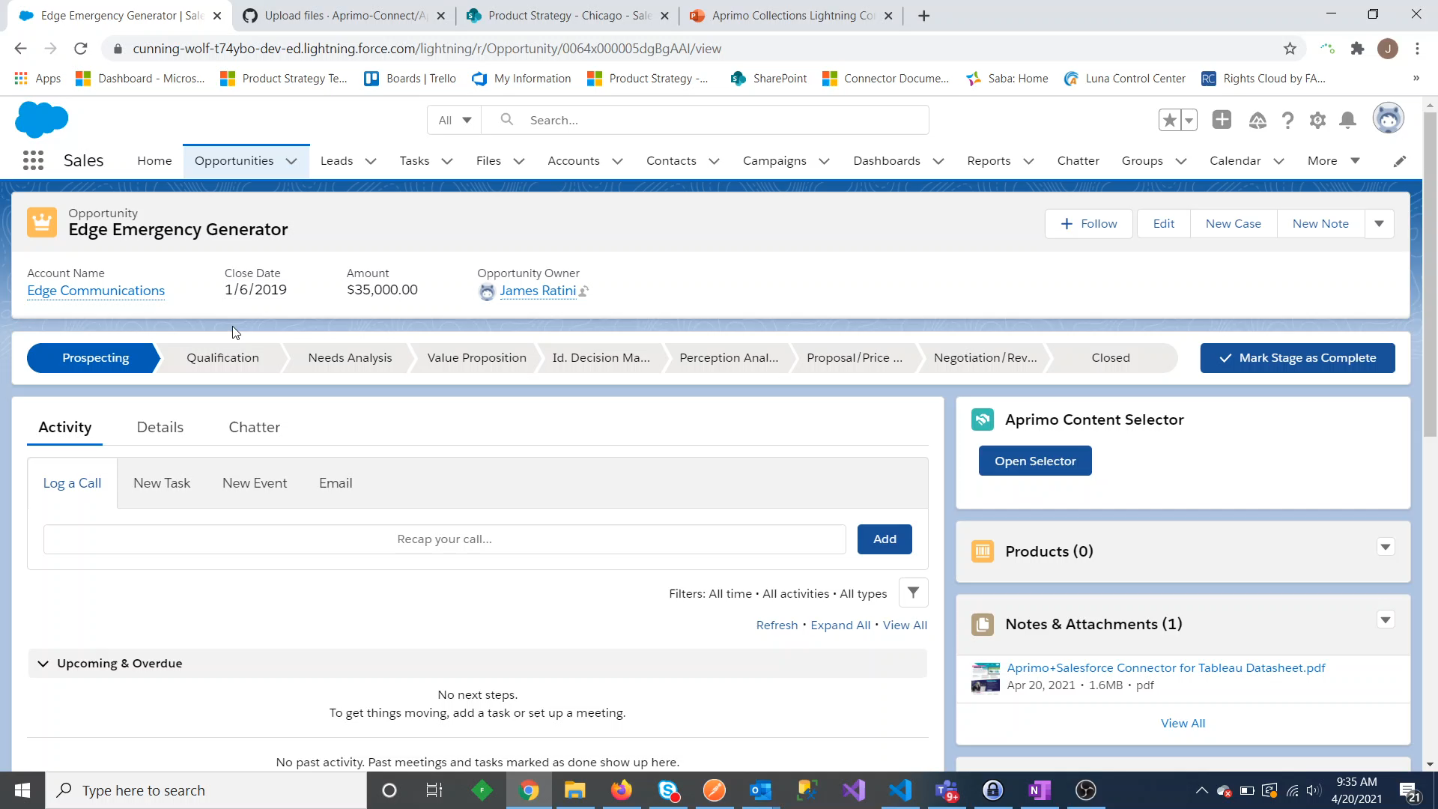
Video

Slide 5
Customer Responsibilities
Set up the logic in the component to map Salesforce data to Aprimo collection
Deploy the Lightning Component on appropriate page layouts
Details on how to install and customize are available in a detailed Integration Guide
<< Link to AppExchange Listing >> / <<GitHub Repo>>

